Slide 1

Align Medical Centre “Analysis of Healthcare Data for Improving Patient Outcomes”

Slide 2
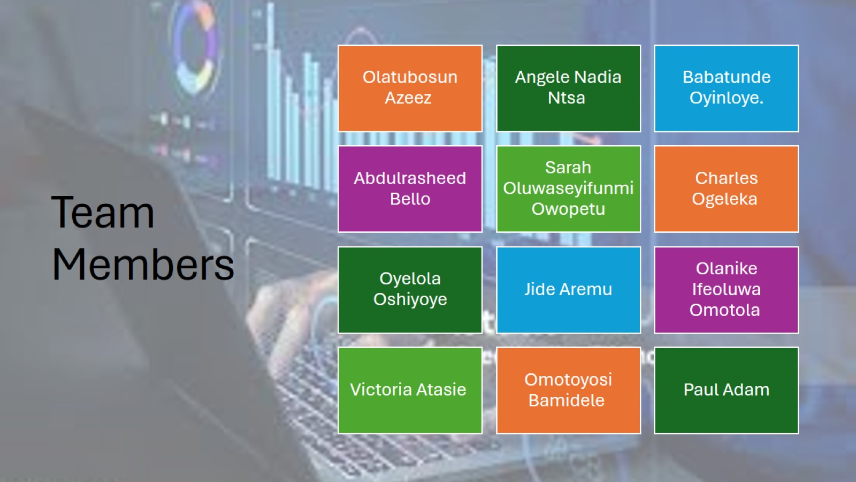
Team Members

Slide 3

Objective

Slide 4
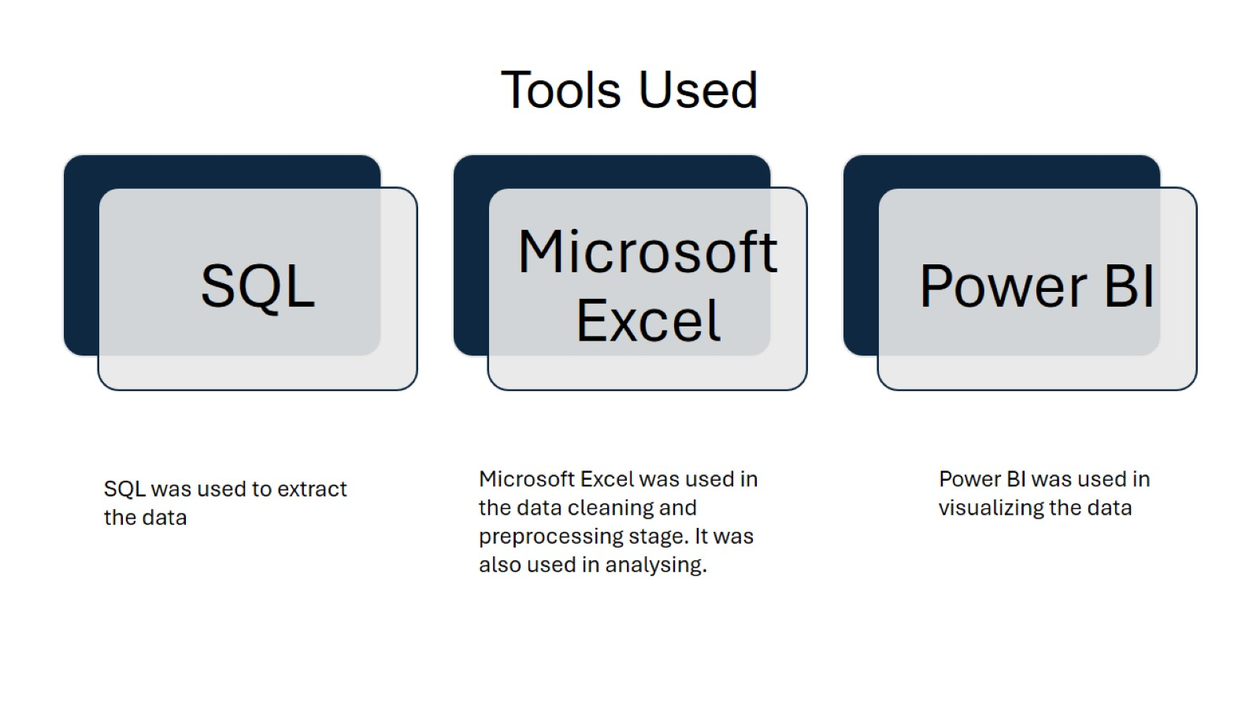
Tools Used

Slide 5
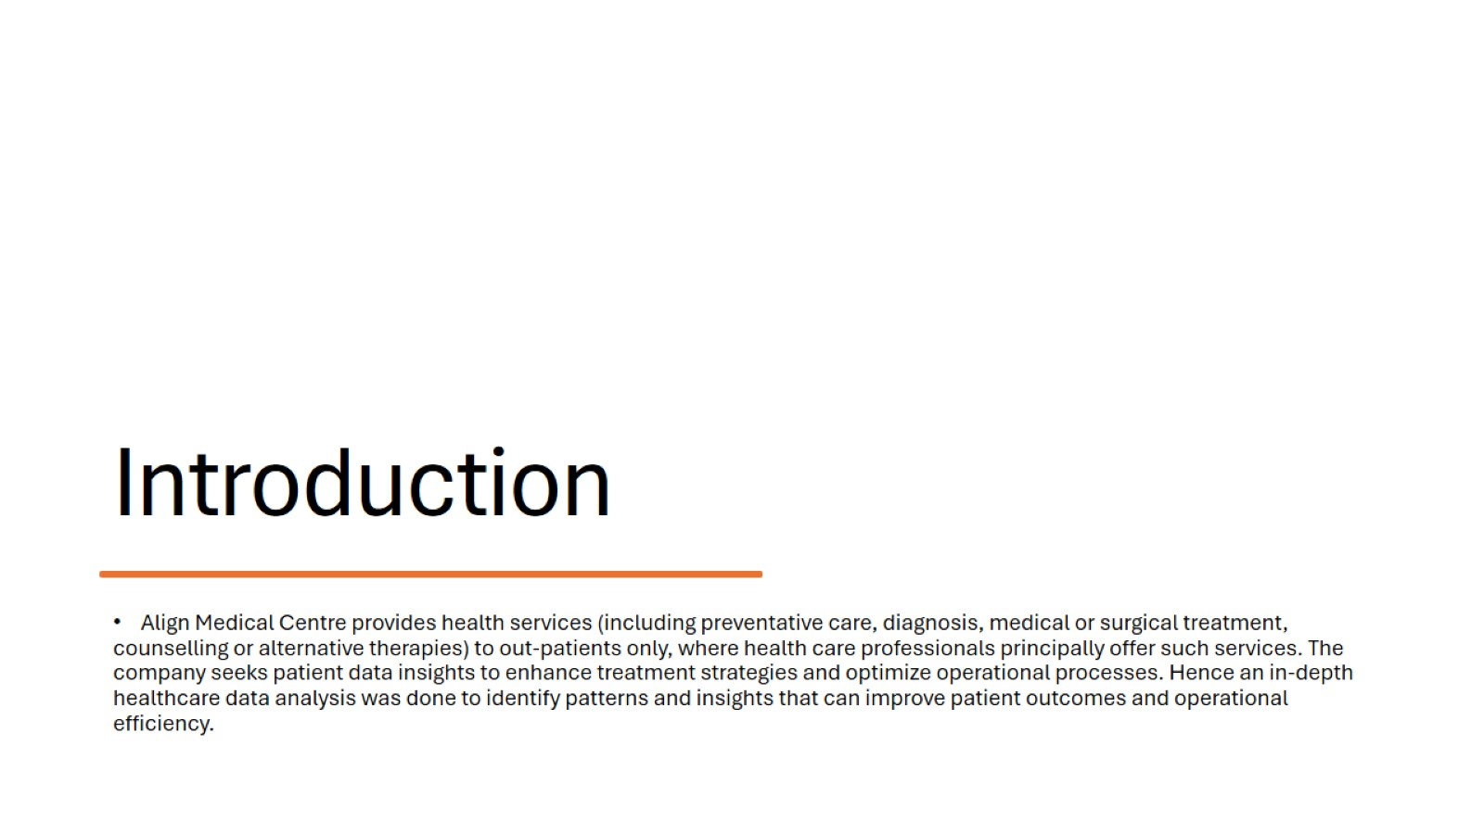
Introduction

Slide 6
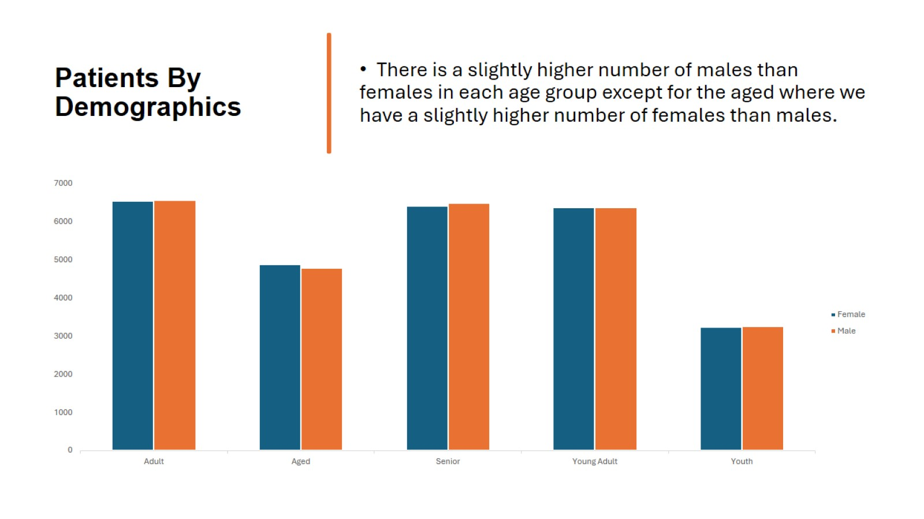
Patients By Demographics

Slide 7
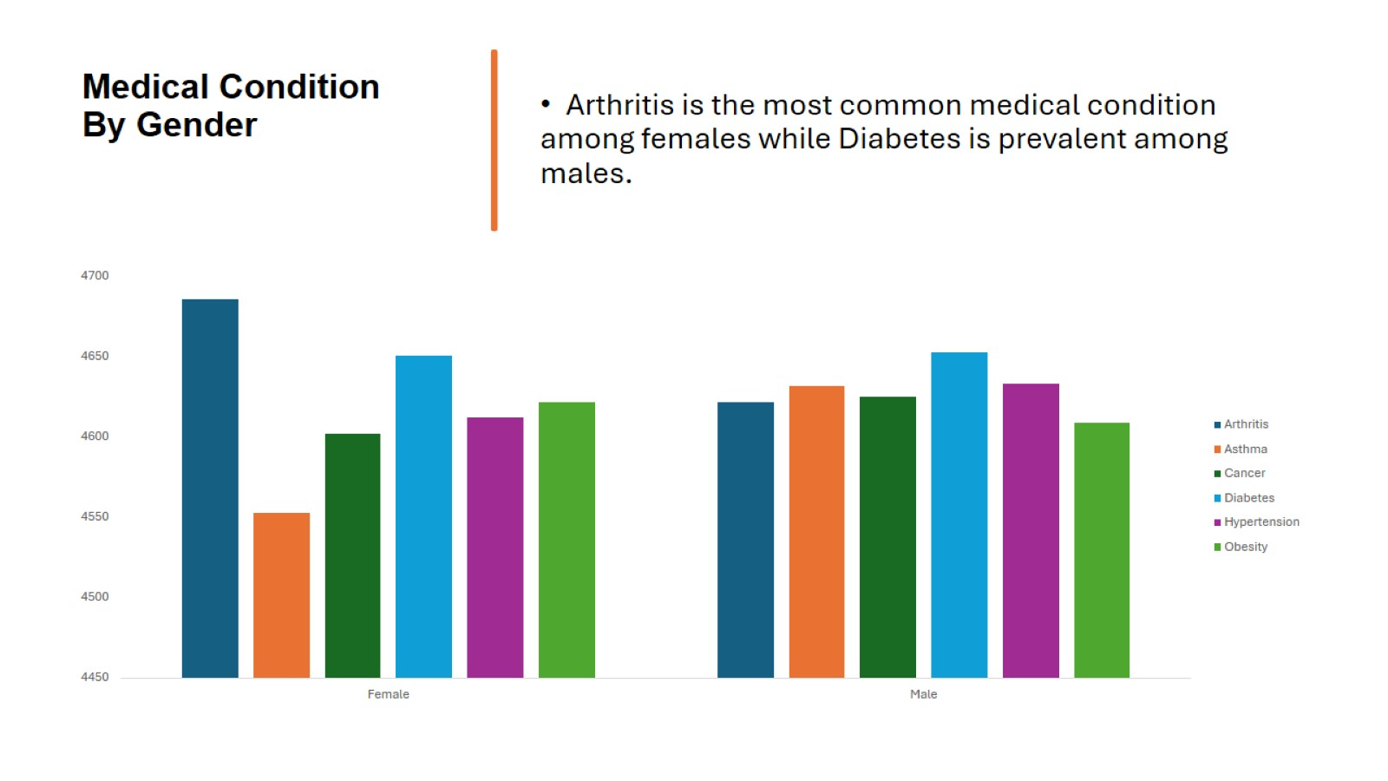
Medical Condition By Gender

Slide 8
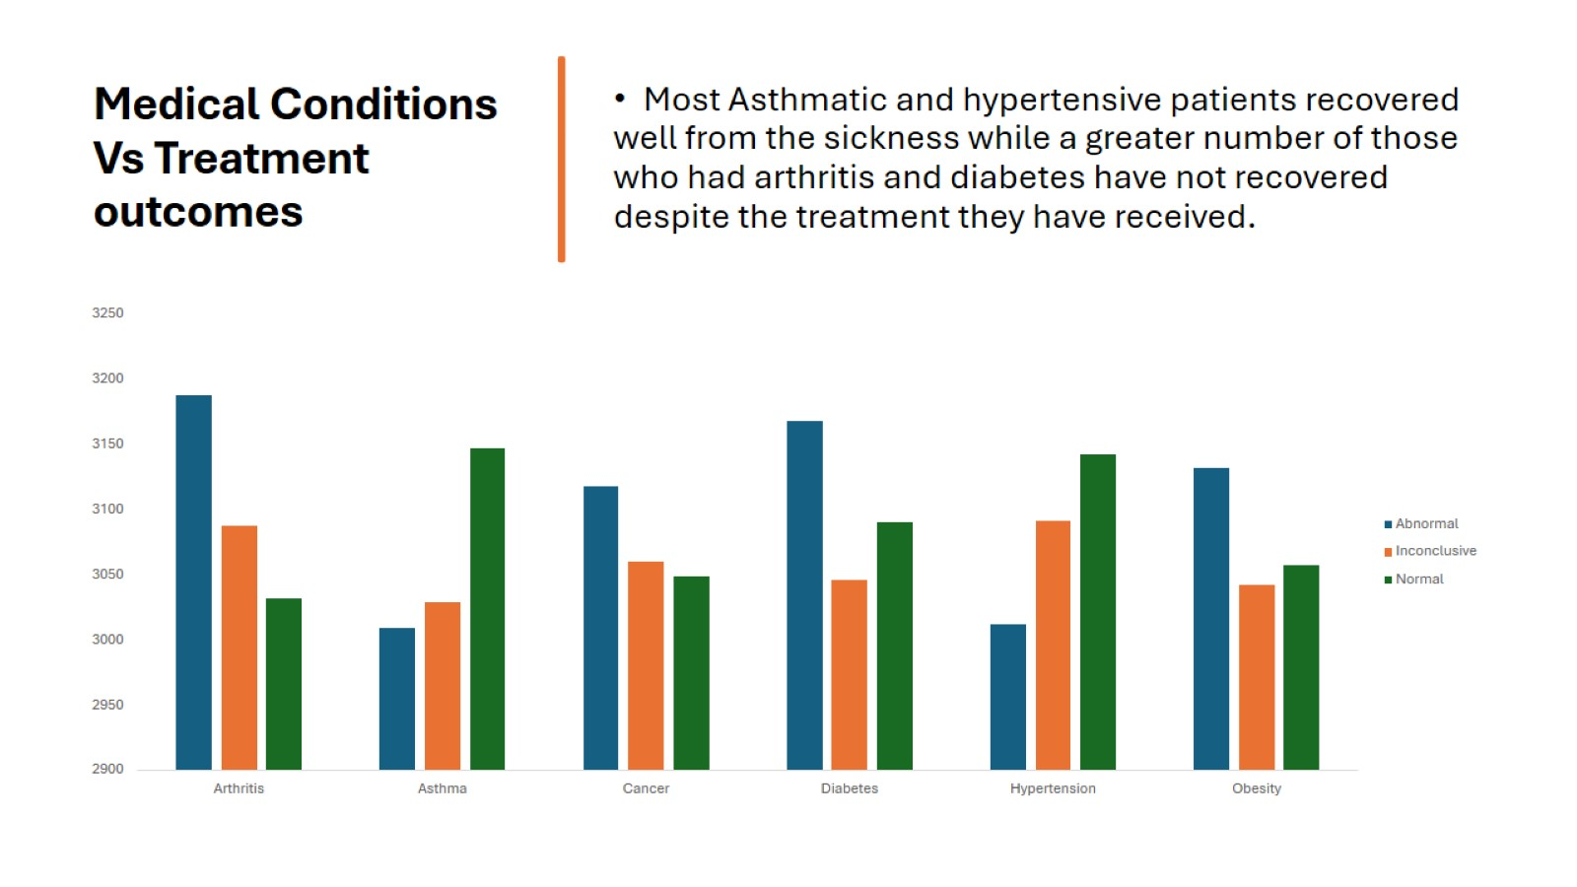
Medical Conditions Vs Treatment outcomes

Slide 9
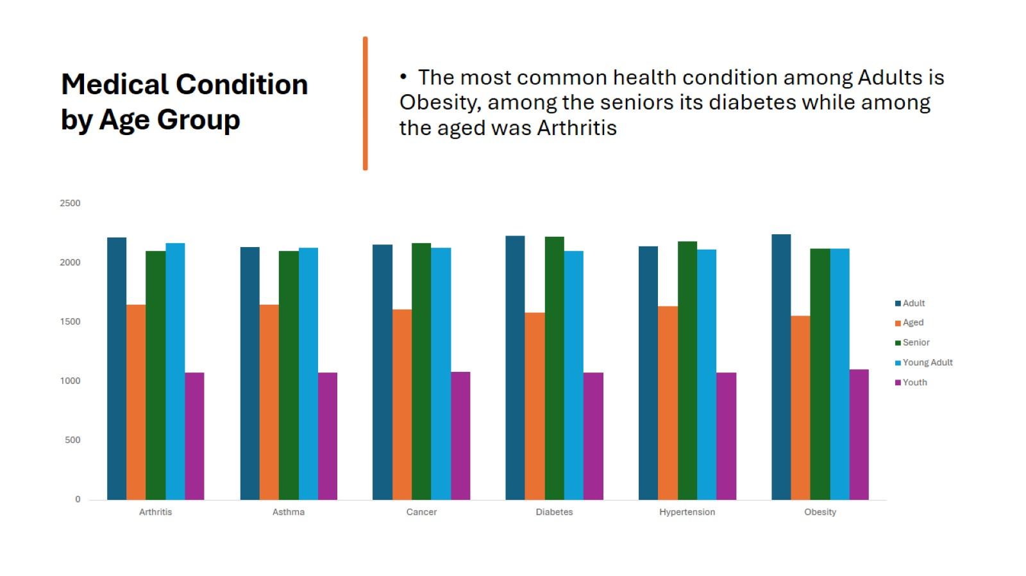
Medical Condition by Age Group

Slide 10
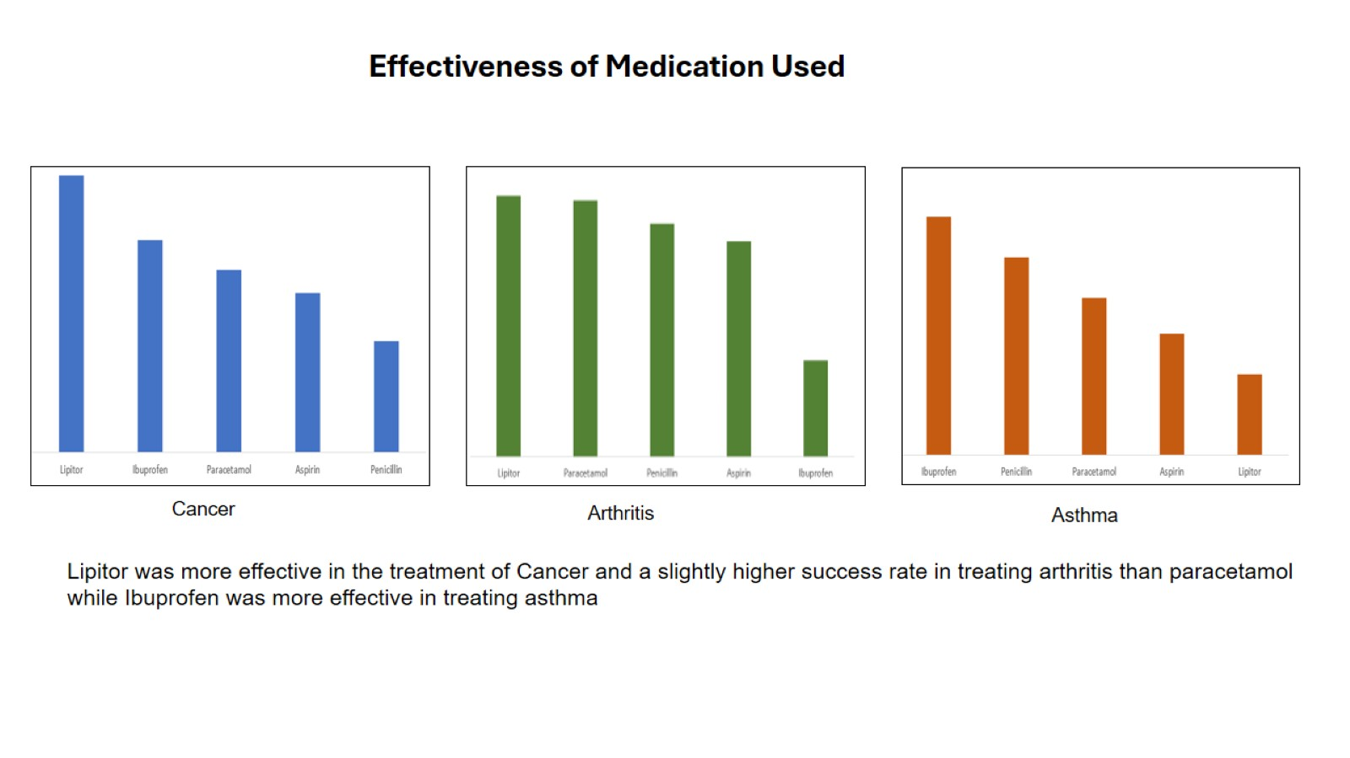
Effectiveness of Medication Used

Slide 11
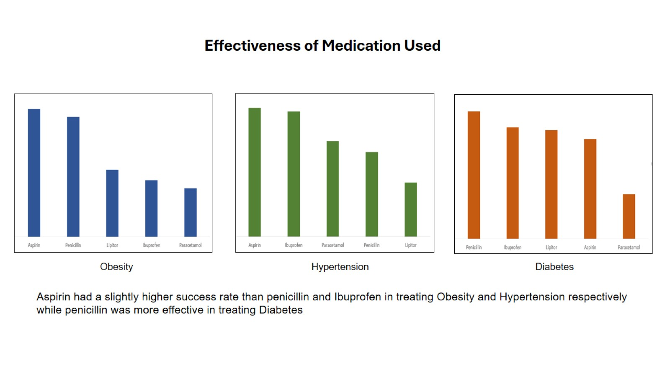
Effectiveness of Medication Used

Slide 12
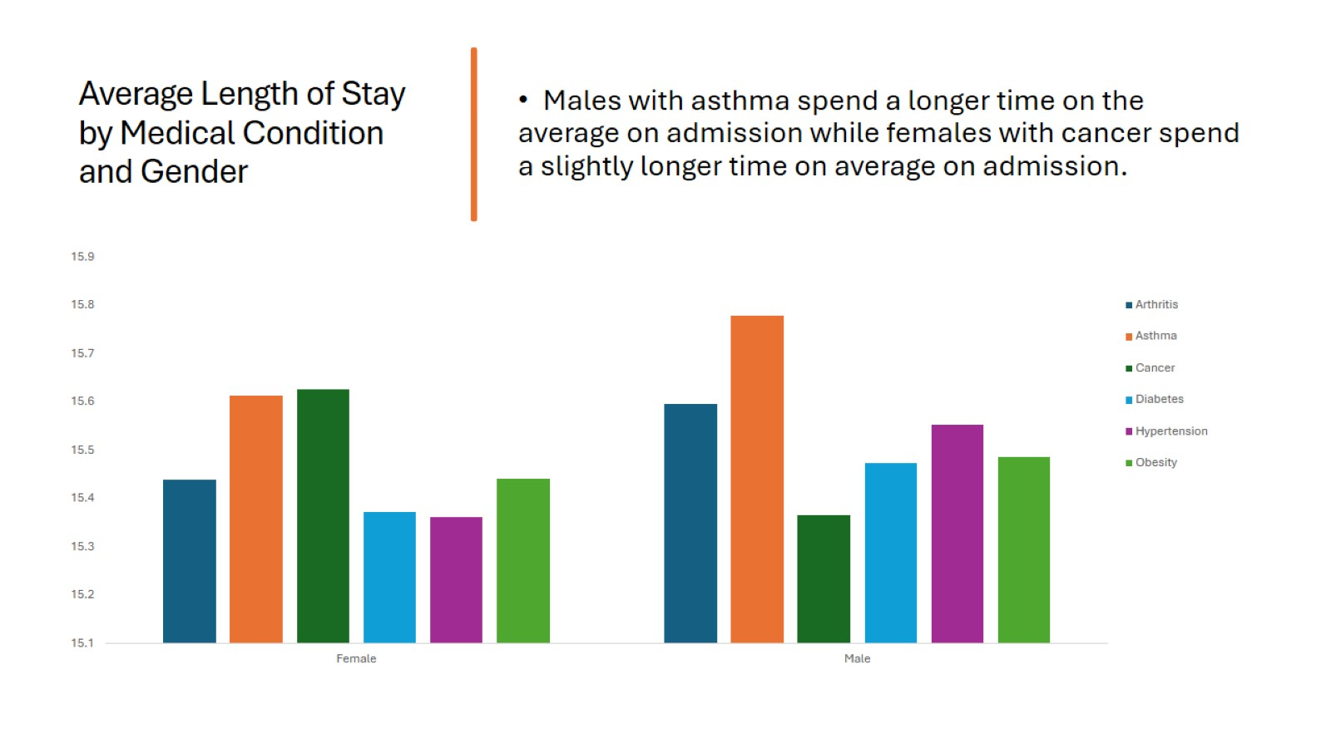
Average Length of Stay by Medical Condition and Gender

Slide 13
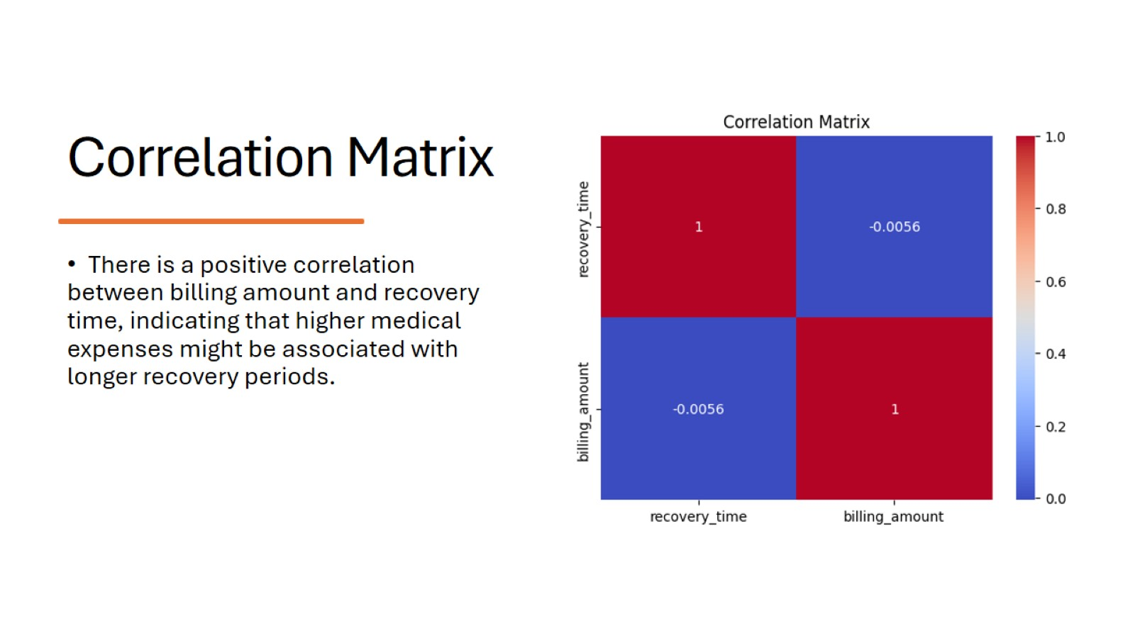
Correlation Matrix

Slide 14
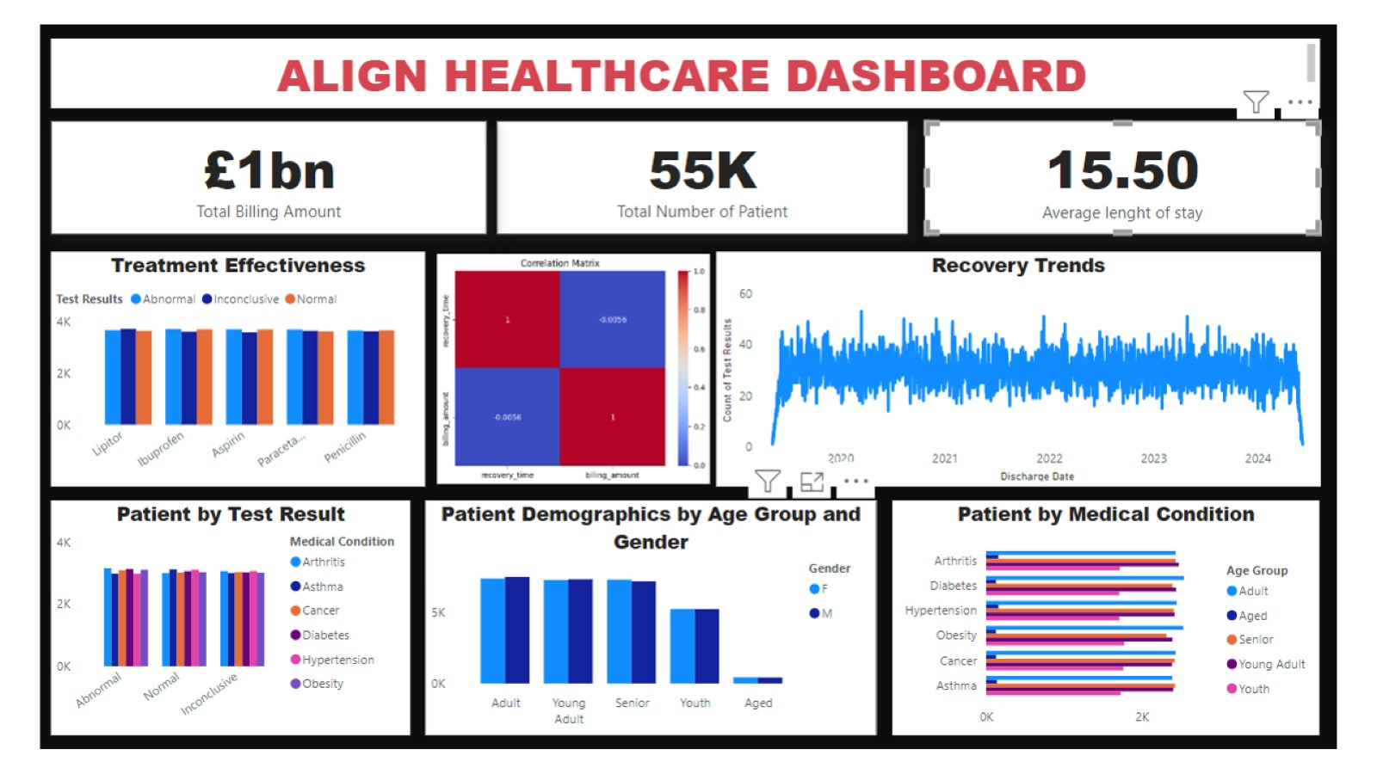

Slide 15
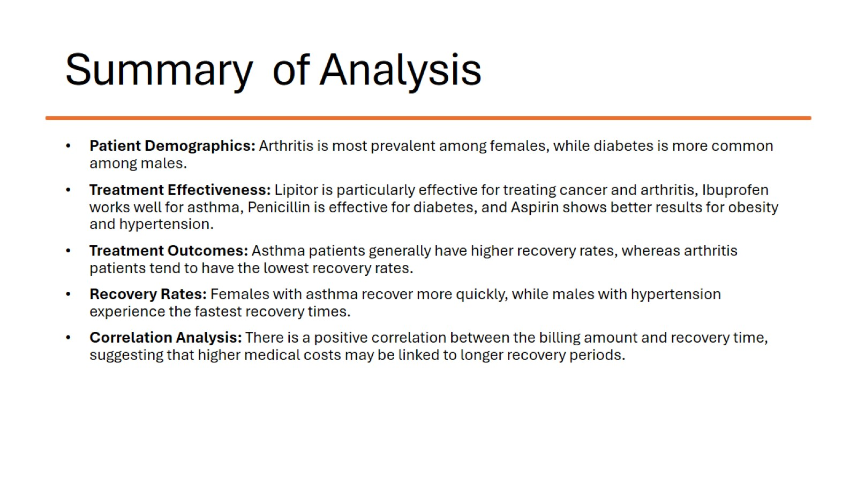
Summary of Analysis

Slide 16
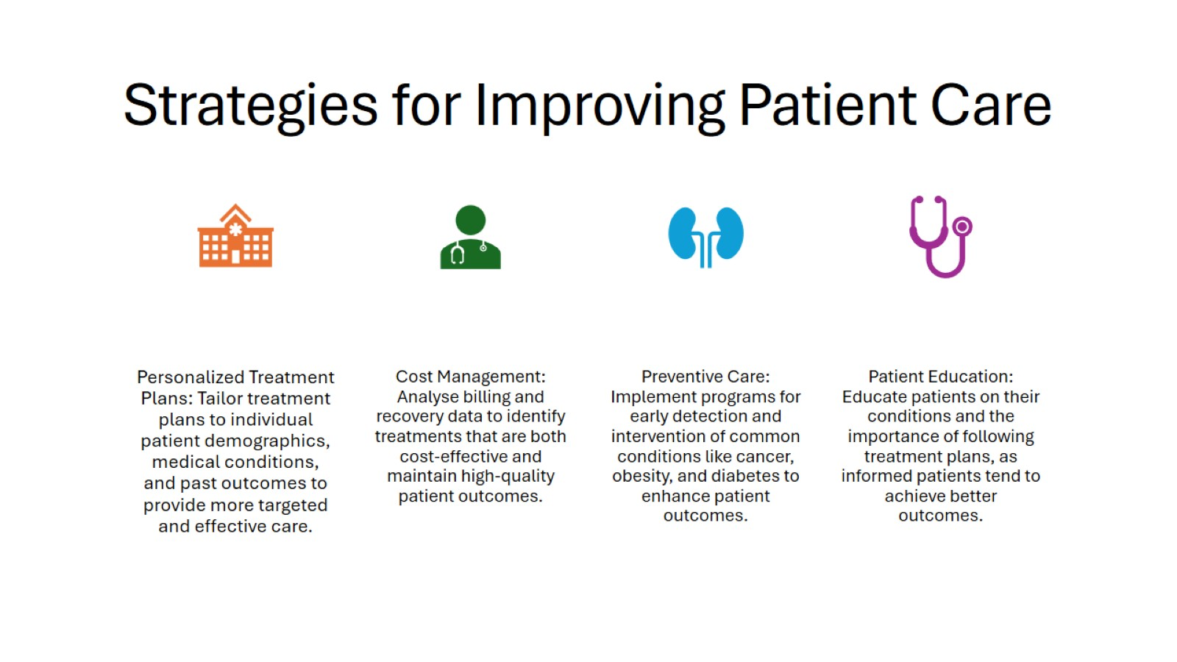
Strategies for Improving Patient Care

Slide 17
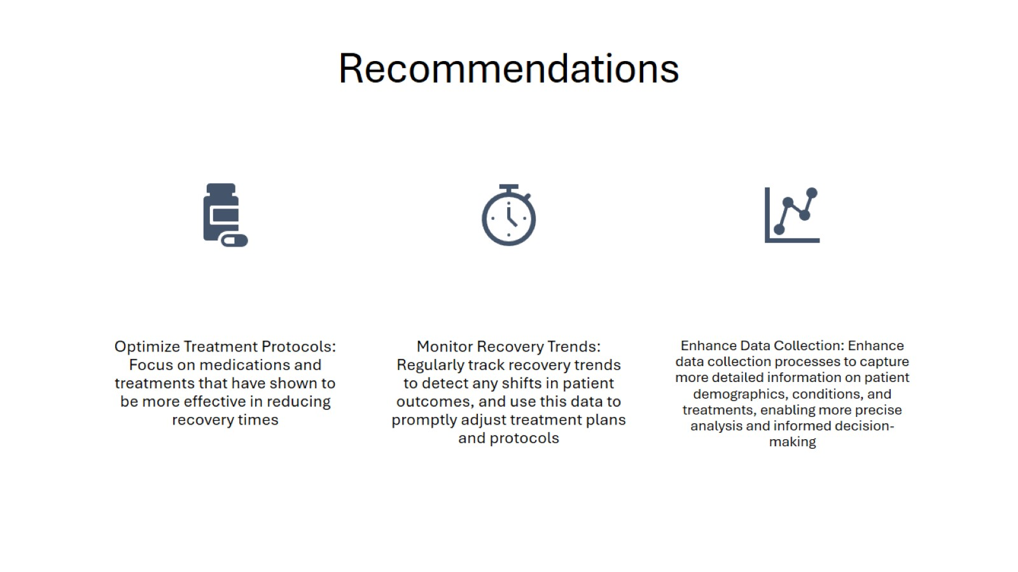
Recommendations

Slide 18

THANK YOU

